Slide 1
Commerce and Entrepreneurship Master Study Programme
EFficiently
Together

Slide 3
Advantages of studying with us
EFficiently
Together
Great value
high quality of teaching, individual approach, focus on practical skills, unique cultural experience
Low costs
reasonable price 2,000 EUR/semester, discount up to 50% in the second year based on study results;
living costs 300 EUR/month (accommodation, catering)
Additional funding for studying abroad for one semester within Erasmus+ programme scheme
Safe, pleasant, vibrant and clean environment

Slide 4
Academic year
EFficiently
Together
Winter semester
13 weeks
October – mid January
2 week break during Christmas period
Summer semester
14 weeks (1st and 2nd year), 10 weeks (last year)
mid February – May
Examination periods
4 weeks after each of semesters

Slide 5
About the study programme
EFficiently
Together
Long tradition and steady innovation
More than 20 years
Stability and success
In Czech and from 2015 in English
Several thousand graduates
Recognised qualification
DS Label (the EU recognition)
Possibility of study abroad
Designed to enable students to study one semester abroad at one of 50 partner universities

Slide 6
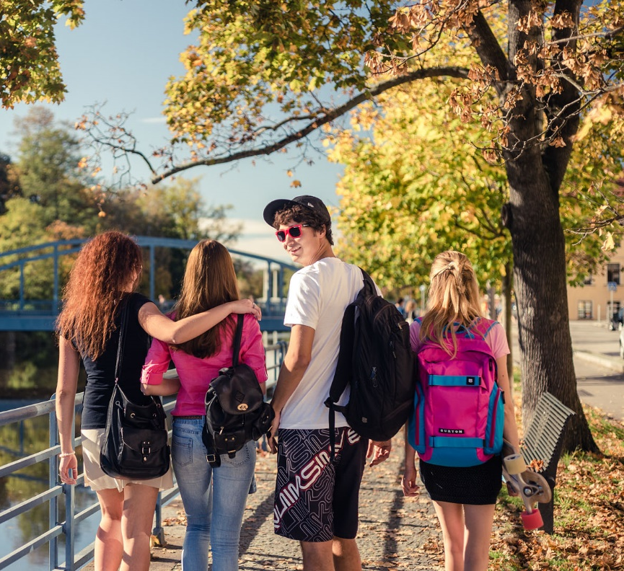
Main features
EFficiently
Together
General business and management foundations based on international standards
Focus on strategic and globally important issues in commerce and entrepreneurship, marketing and tourism
Up-to-date knowledge as well as practical skills development through project work
Professors and students from various European countries and Australia – transcultural perspective

Slide 7
Study plan
EFficiently
Together
2 years, 120 ECTS credits
83 ECTS credits – core subjects
10 ECTS credits – specialisation project
12 ECTS credits – master thesis
min. 15 ECTS credits – elective subjects
1st year – core subjects
2nd year – specialisation and elective subjects, thesis
final state examination and thesis defense

Slide 8
Core subjects
EFficiently
Together
Economics
Microeconomics II, Macroeconomics II, Managerial Economics
Management in Trade and Tourism
Management II, Human Resource Management, Strategic Management in Trade and Tourism, Cooperation in Trade
Marketing
Consumer Behaviour, Strategic Marketing, International Marketing, Marketing Communication
International Trade and Tourism
International Trade, International and EU Law, International Tourism

Slide 9
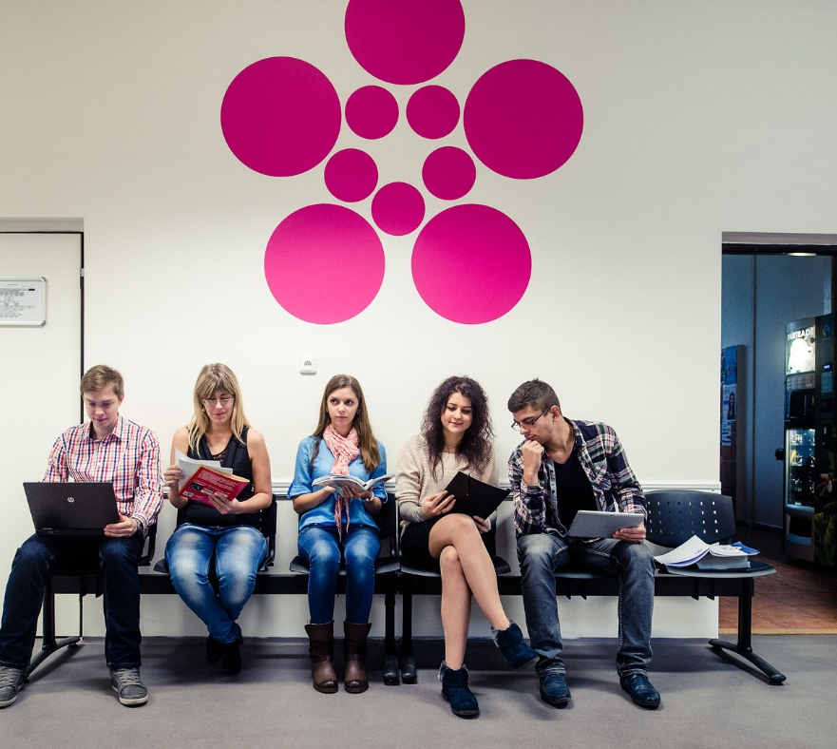
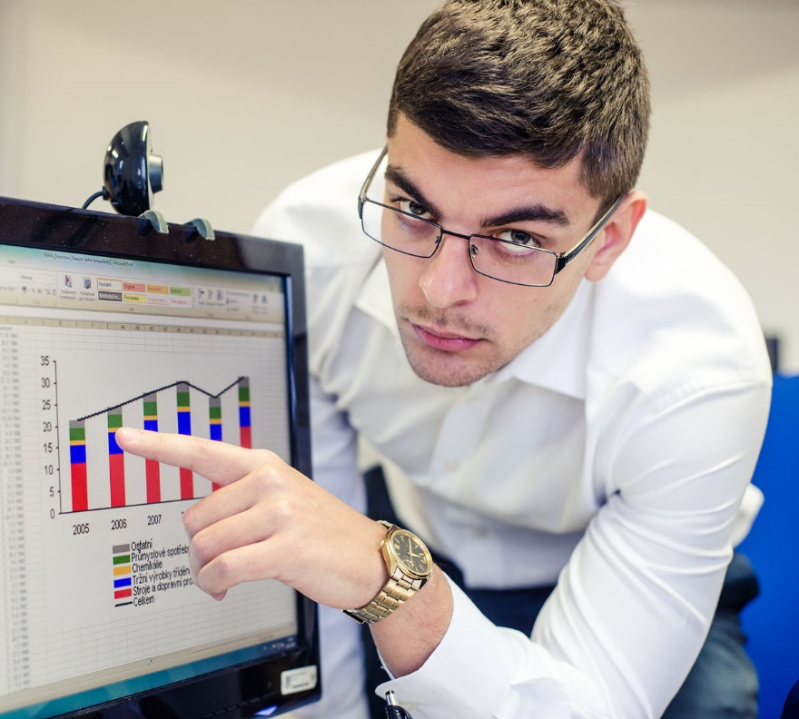
Specialisation and elective subjects
EFficiently
Together
E-business and E-commerce
Multimedia
Web Application Design
Microsoft Dynamics Ax
Business Skills
and many others

Slide 10
Cooperation with industry
EFficiently
Together
Focused skills and knowledge development through 2-semester specialisation projects lead by people from industry
Cooperation with wide range of partners – local and multinational companies, institutions

Slide 11
Typical careers
EFficiently
Together
Management and professional positions in multinational companies, mainly in retailing, e-commerce, hospitality and tourism
Marketing professionals
International trade professionals
Entrepreneurs

Slide 12
Entrance procedure
EFficiently
Together
Application deadline: April 15, 2018
Entrance requirements:
Bachelor degree in business/economics
command of English (CEFR level B2)
Skype interview (interest in study, exam from economics/trade)
more info

Slide 13
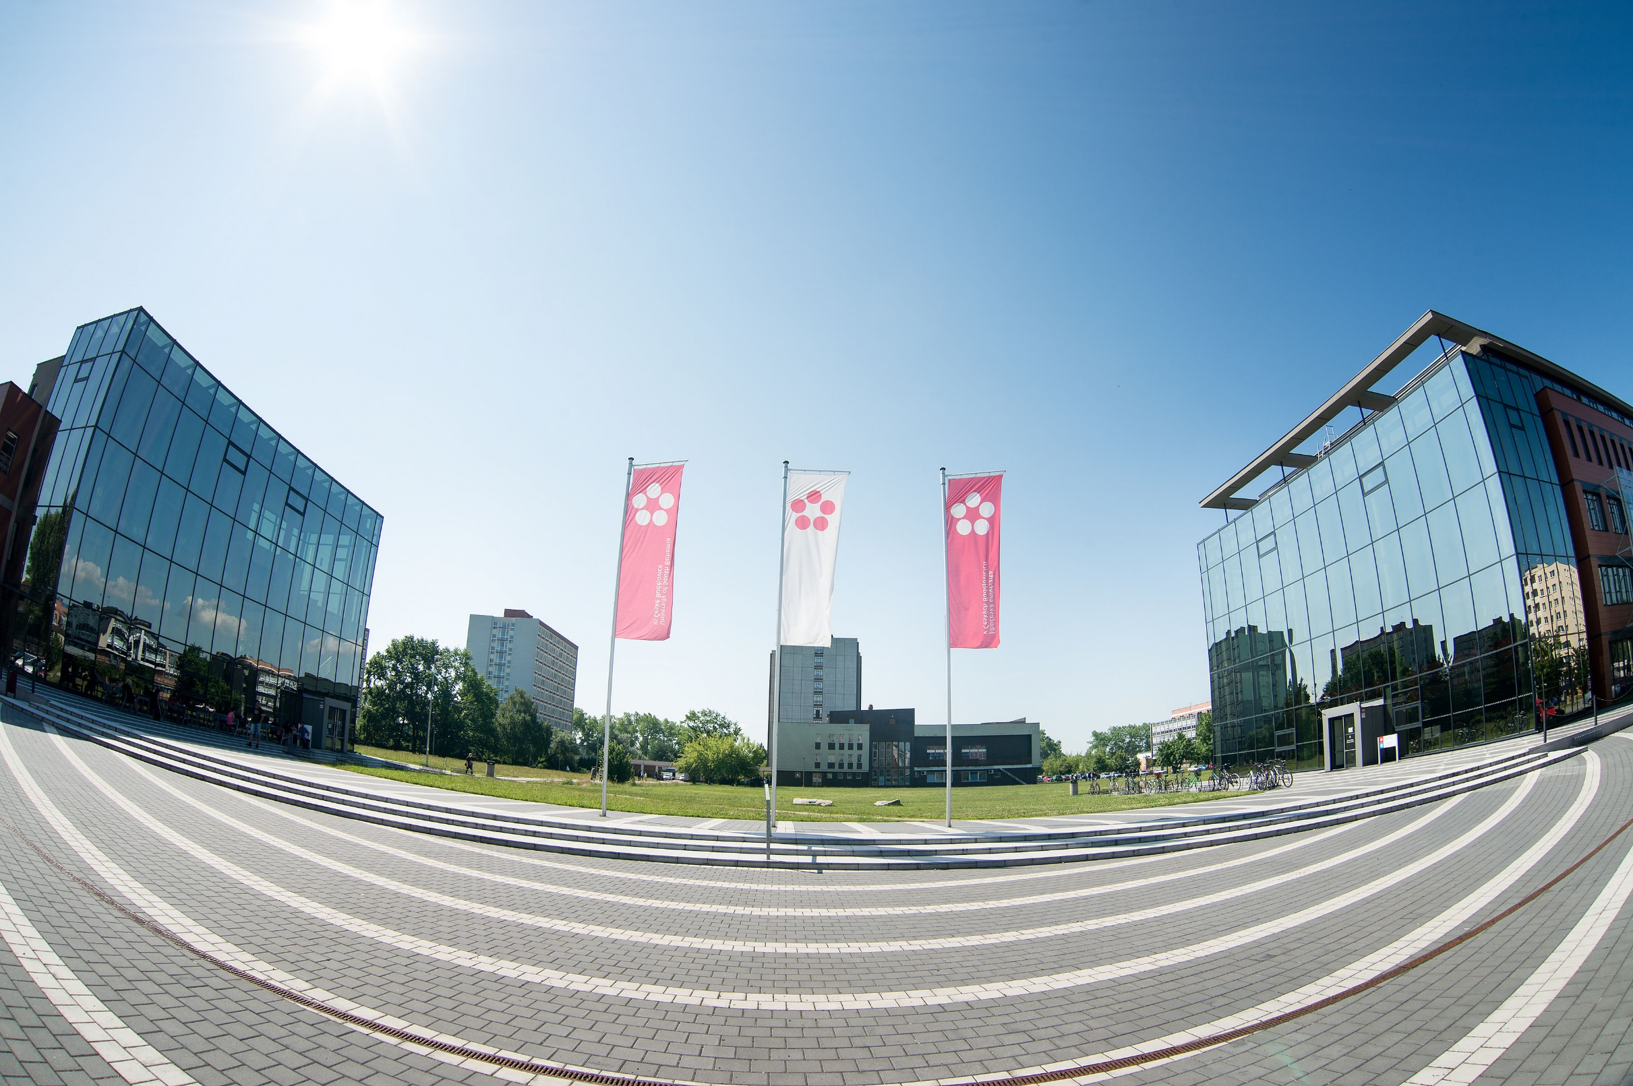
Interested? Join us! more info: www.ef.jcu.cz e-mail: vojtko@ef.jcu.cz
EFficiently
Together

