Slide 1
Economic Informatics undergraduate Bachelor’s study program
EFficiently
Together

Slide 3
Advantages of studying with us
EFficiently
Together
Great value
high quality of teaching, individual approach, focus on practical skills, unique cultural experience
Low costs
reasonable price 1,500 EUR/semester, discount up to 50% in the second year based on study results;
living costs 300 EUR/month (accommodation, catering)
Additional funding for studying abroad for one semester within Erasmus+ programme scheme
Safe, pleasant, vibrant and clean environment

Slide 4
Academic year
EFficiently
Together
Winter semester
13 weeks
October – mid January
2 week break during Christmas period
Summer semester
14 weeks (1st and 2nd year), 10 weeks (last year)
mid February – May
Examination periods
4 weeks after each of semesters

Slide 5
About the study programme
EFficiently
Together
Standard contents
similar to comparable study programme from abroad
e. g. Business Informatics, Wirtschaftsinformatik
Stability and success
in Czech and since 2015 also in English
dozens of successful graduates
Recognised qualification
DS Label (the EU recognition)
Possibility of study abroad
Designed to enable students to study one semester abroad at one of 50 partner universities
Combined knowledge
combination of knowledge in fields of Computer Science, Economics and Business with practice opportunities

Slide 6
Main features
EFficiently
Together
Standard contents
similar to comparable study programme from abroad
October – mid January
2 week break during Christmas period
Combination tability and success
in Czech and since 2015 also in English
dozens of successful graduates
Recognised qualification
DS Label (the EU recognition)
Possibility of study abroad
Designed to enable students to study one semester abroad at one of 50 partner universities

Slide 7
Study plan
EFficiently
Together
3 years, 180 ECTS credits
140 ECTS credits – core subjetcs
30 ECTS credits – specialisation subjects
min. 10 ECTS credits – elective subjects
Combination tability and success
1st year – core subjects
2nd year – core and specialisation subjects
3rd year – specialisation and elective subjects, thesis
final state examination and thesis defense

Slide 8
Core subjetcs
EFficiently
Together
Computer Science
Basic Programic, Database Systems, Web Design, Business Information Systems, Information and Communication Networks
Economics
Microeconomics, Macroeconomics, Principles of Accounting
Management and Marketing
Management, Marketing, Project Management, Law

Slide 9
Specialisation and elective subjects
EFficiently
Together
E-business and E-commerce
Multimedia
Web Application Design
Microsoft Dynamics Ax
Business Skills
and many others

Slide 10
Cooperation with industry
EFficiently
Together
Focused skills and knowledge development through semester projects lead by experts from IT industry
Cooperation with wide range of partners (local and multinational comapnies) from industry and IT area

Slide 11
Typical careers
EFficiently
Together
information system analyst
application system manager
business consultant
programmer
web application developer
business representative for IT
Entrepreneurs in IT sector

Slide 12
Entrance procedure
EFficiently
Together
Application deadline: April 15, 2018
Entrance requirements:
secondary school graduates with secondary school diploma nostrification
command of English (CEFR level B1, TOEFL score 35 points)
Skype interview (interest in study, scholastic aptitude, basic orientation in IT)
more info

Slide 13
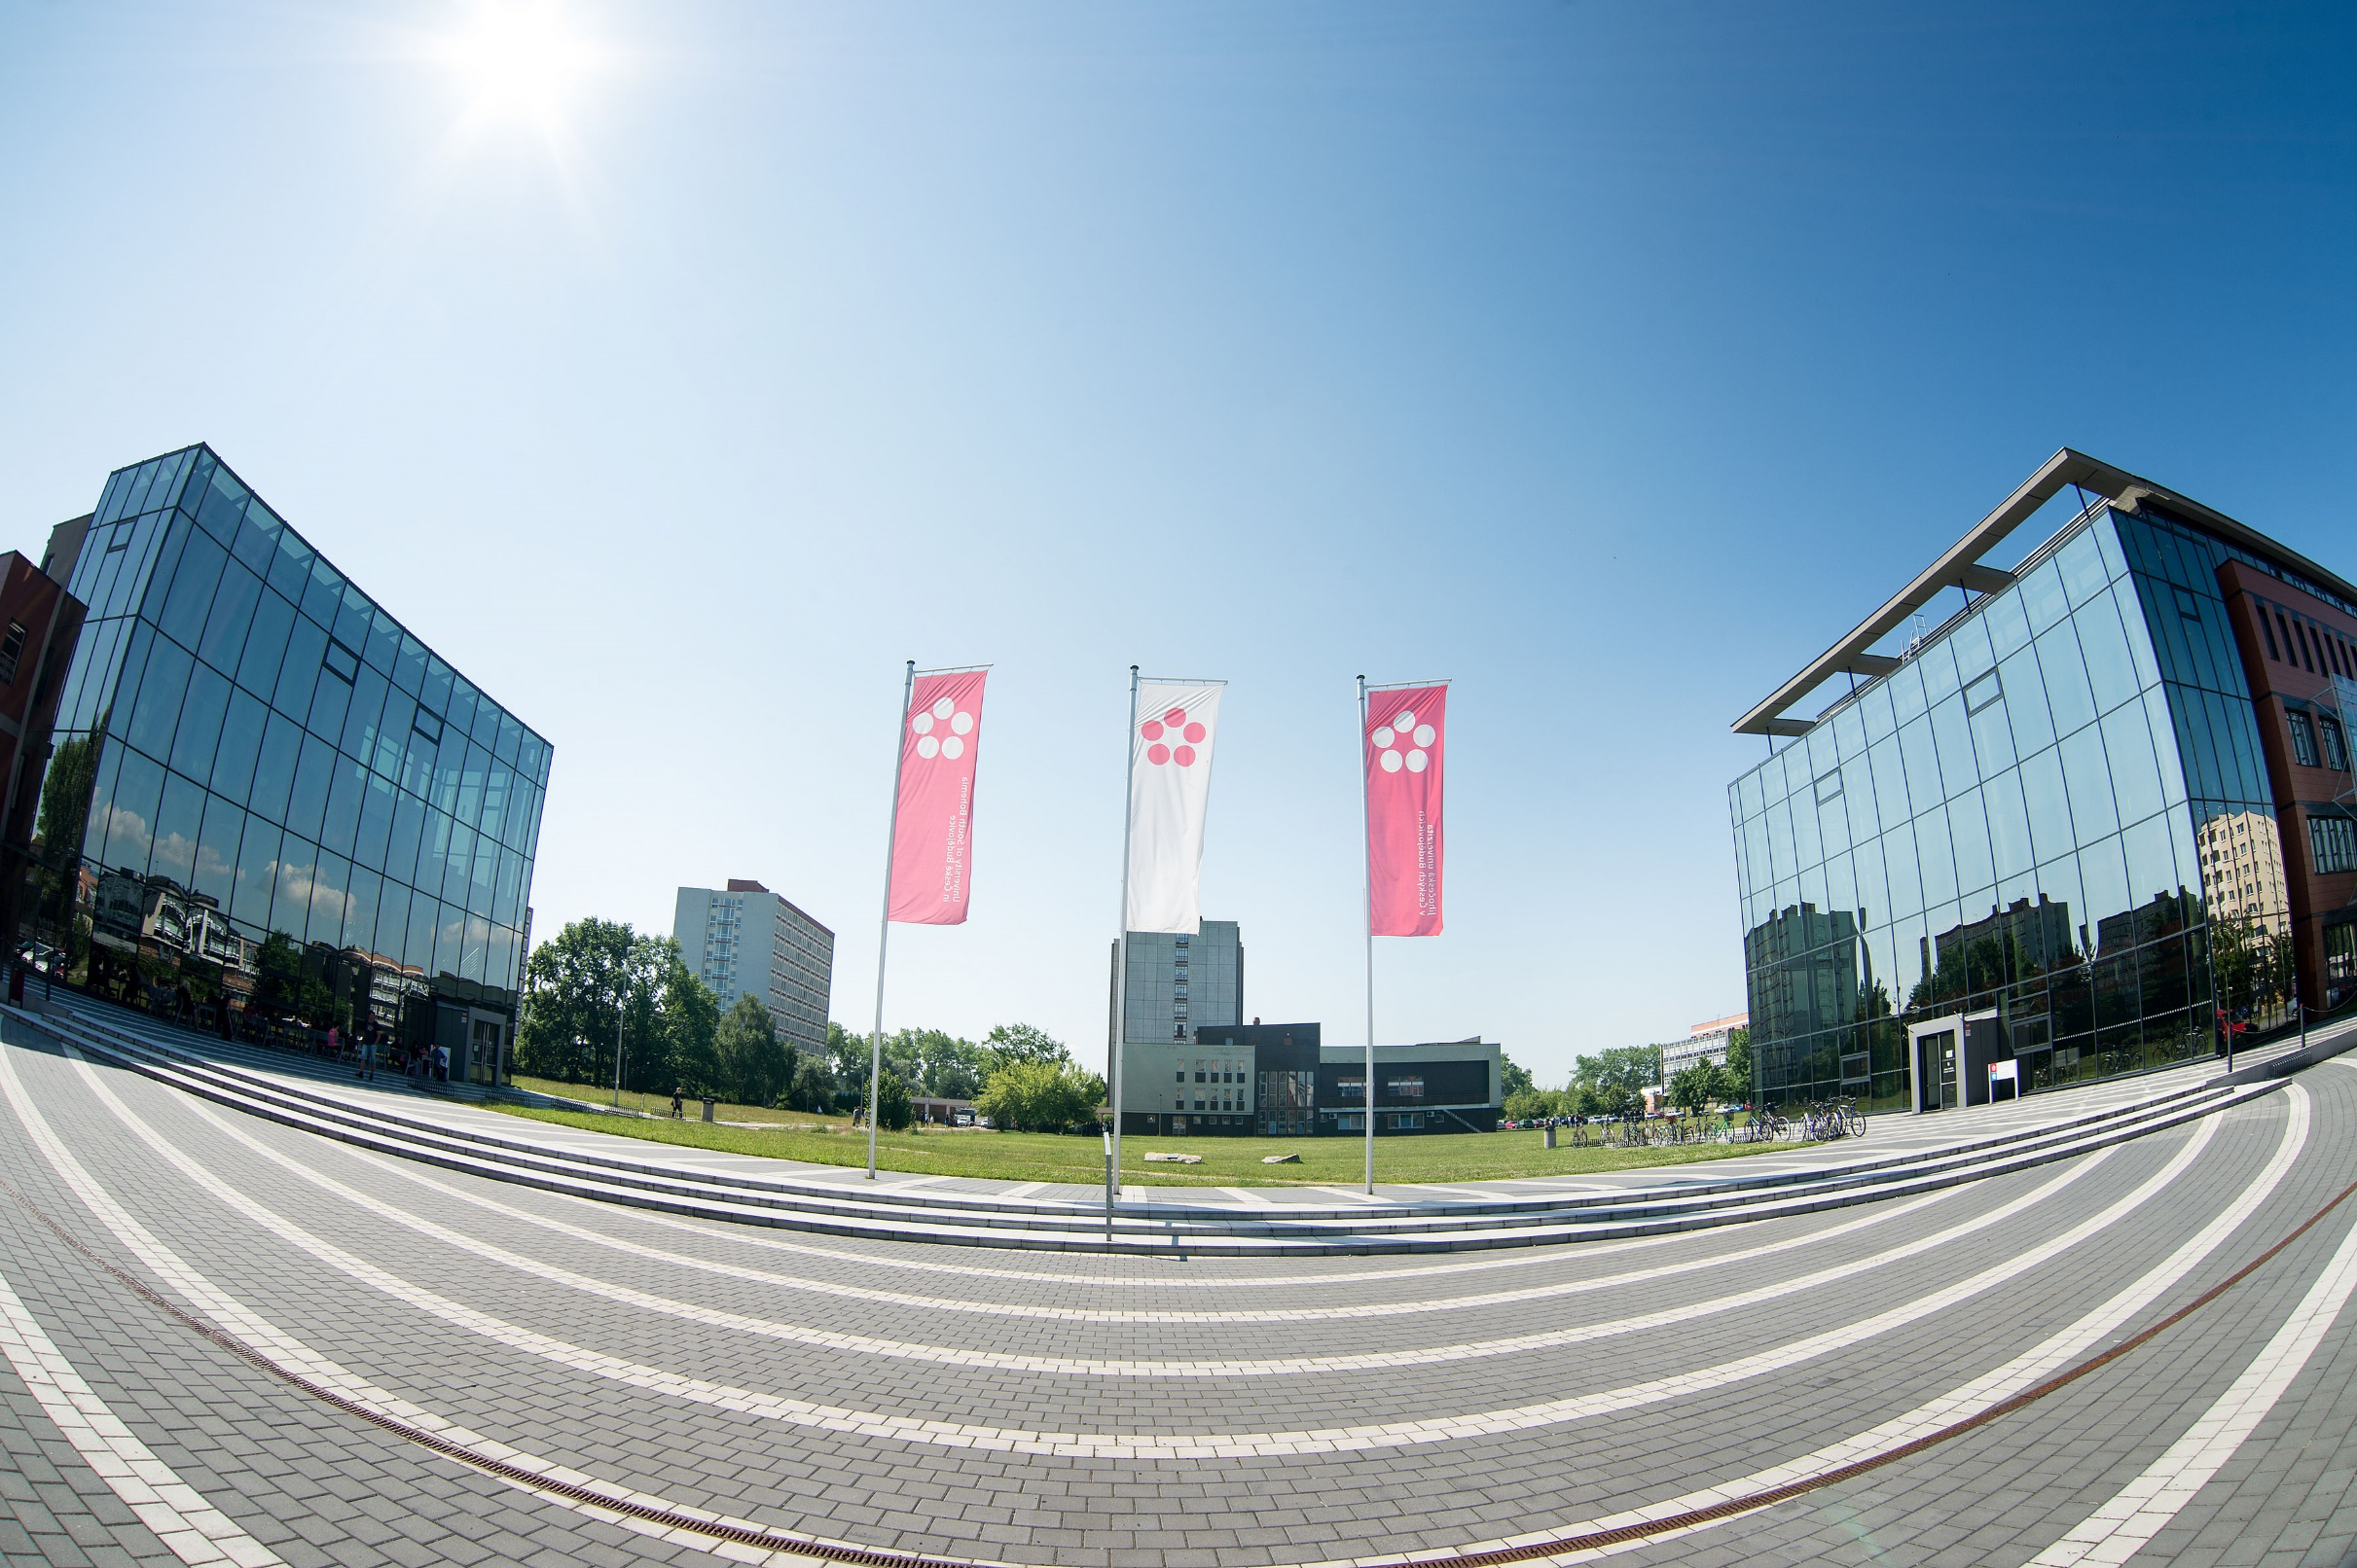
Interested? Join us! more info: www.ef.jcu.cz e-mail: beranek@ef.jcu.cz
EFficiently
Together

